Slide 1

MAULANA AZAD NATIONAL INSTITUTE OF TECHNOLOGY, BHOPAL
Department of Mathematics, Bioinformatics and Computer Applications
PRESENTATION ON :
Sentiment Analysis of Tweets
PRESENTED BY:
AKSHAY KUMRAVAT (212120106)
SHIVAM GURJAR(212120105)
UNDER THE GUIDANCE OF :
DR. AMIT BHAGAT SIR

Slide 2
A Twitter sentiment analysis is the process of determining the sentiment behind the tweet. It is also referring as opinion analysis
What is sentiment analysis?

Slide 3
What to determine?
😄
😑
😢
Positive
Neutral
Negative

Slide 4
MATERIALS AND METHODS
Source of twitter data set :
https://www.kaggle.com/datasets/jp797498e/twitter-entity-sentiment-analysis
The data is collected from the Kaggle repositories.
Twitter sentiment Analysis Dataset is taken from Kaggle Website that consist 76680 of rows and 4 columns ( ids, location, target, text).
Description of the data set : It has the following attributes..
Ids: Unique id of the tweet.
Location: It refers to the location of the tweet.
Target: the polarity of the tweet (Positive ,Negative and Neutral).
Text: It refers to the text of the tweet.

Slide 5
1.In sentiment analysis of twitter, proposed method primarily used to perform five key tasks:
Input (Keyword)
Tweets Retrieval
Data Pre-Processing
Sentiment in graphical representation
Classification Algorithm
Classified Tweets

Slide 6
2. Clean the data using pre-processing
techniques
Input Tweet
1.Remove Emoticons “☺”.
2.Replace “thnx” to “thanks”
3.Remove punctuation symbols.
4.Remove stop words {it ,was ,to ,all ,my}.
It was great match played yesterday ☺,thnx to all my friends
Tokenization
{ great ,match ,played ,yesterday ,thanks ,friends }
Text Cleaning
PoS Tagging
{great/JJ , match/NN , played/VBD , yesterday/NN , thanks/NN , friends/NN}
Stemming
great/JJ , match/NN , play/VBD , yesterday/NN , thank/NN , friend/NN}

Slide 7
Process Flowchart :
Training set
Positive
Tweets
Neutral
Tweets
Negative
Tweets
Data Pre-Processing
Feature Extractor
Tweets
Sentiment analysis Classifier
Model
Positive
Tweets
Classification
Neutral
Tweets
Negative
Tweets

Slide 8
Steps involved in data preprocessing
1.Making statement text in lowercase.
2.Cleaning and removing the stop words from the tweet text.
3.Cleaning and removing punctuations.
4.Cleaning and removing repeating characters.
5.Cleaning and removing URLs.
6.Cleaning and removing numeric numbers.
7.Getting tokenization of tweet text(Tokenization is the process of splitting a string into a list of tokens.)
8.Applying stemming(reducing the words to their derived stems).
9.Applying lemmatizer(reducing the derived words to their root form, known as lemma).

Slide 9
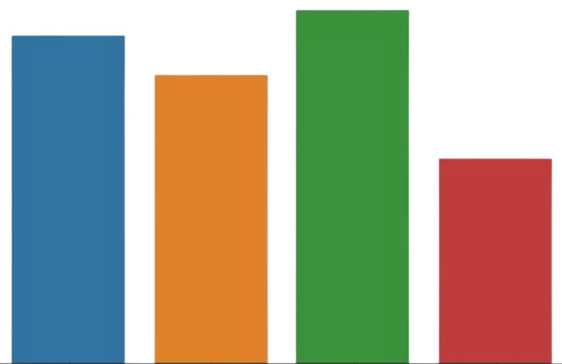
4.Analyze Twitter data using sentiment analysis model
20000
15000
count
10000
5000
0
Positive
Neutral
Negative
Irrelevant
Target

Slide 10
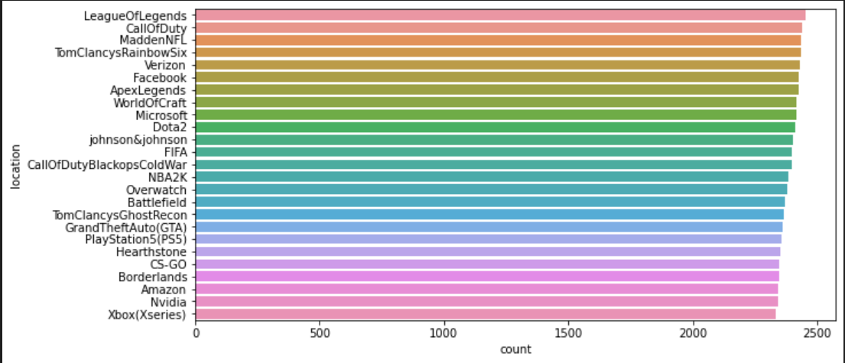
Bar graph

Slide 11
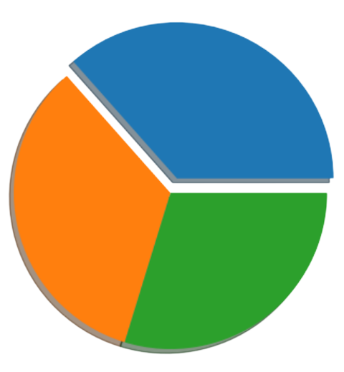
Pie chart
Negative
36.5%
33.8%
Positive
29.7%
Neutral

Slide 12
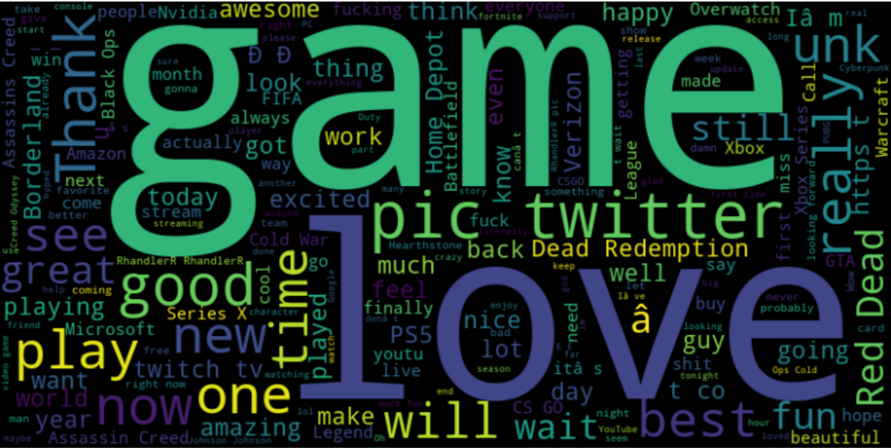
Word cloud of positive words

Slide 13
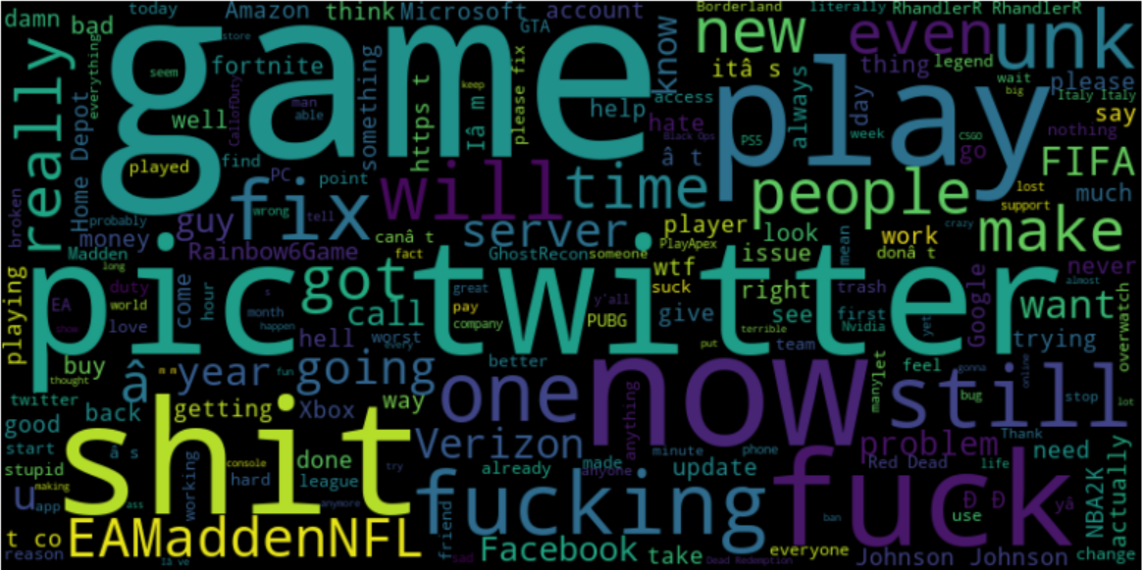
Word cloud of Negative words

Slide 14
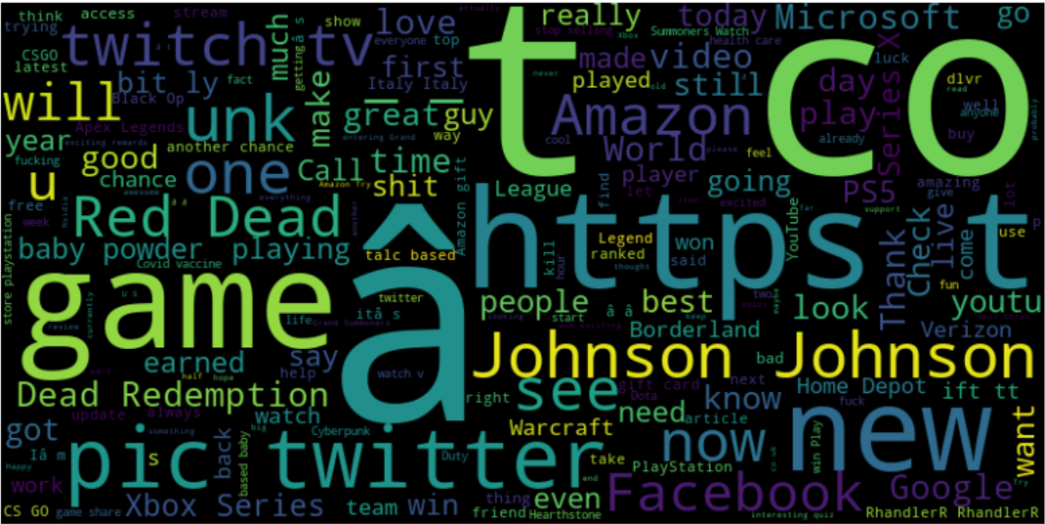
Word cloud of Neutral words

Slide 15
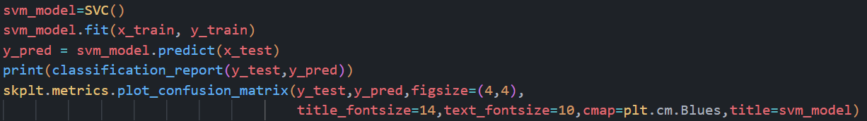
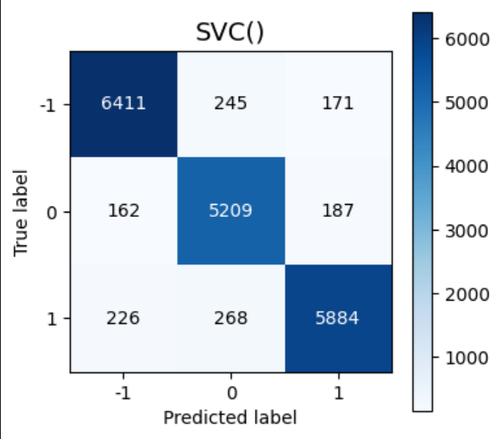
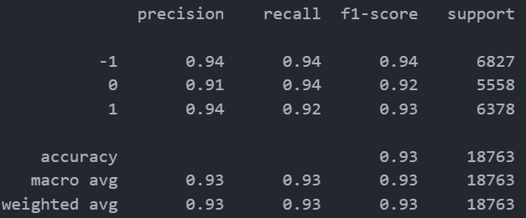
RESULTS
A.SVM(Support Vector machine)

Slide 16
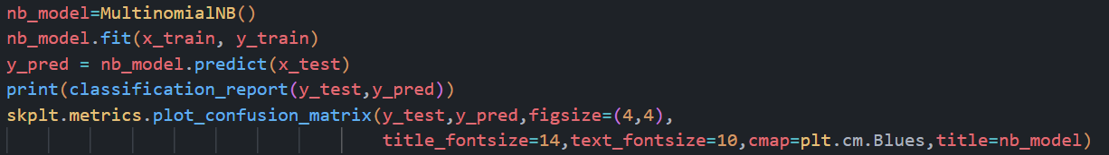
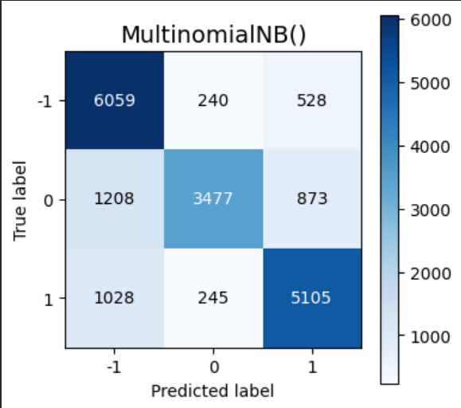
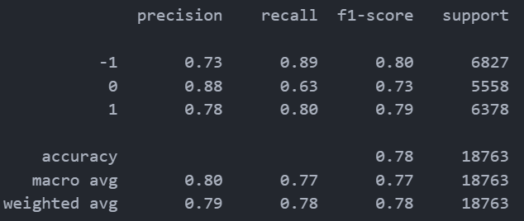
B.Naive Bayes(Multinomial)

Slide 17
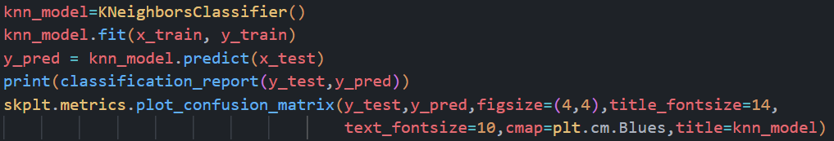
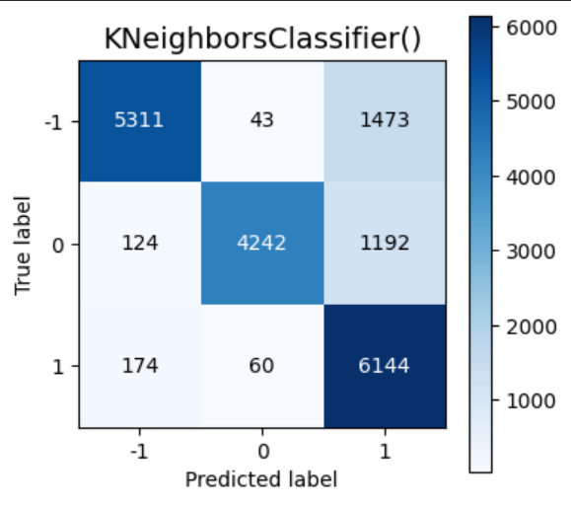
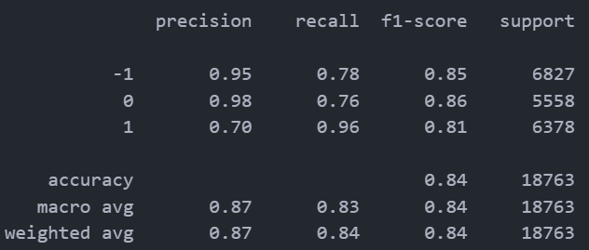
C.KNN(K – Nearest Neighbor)

Slide 18
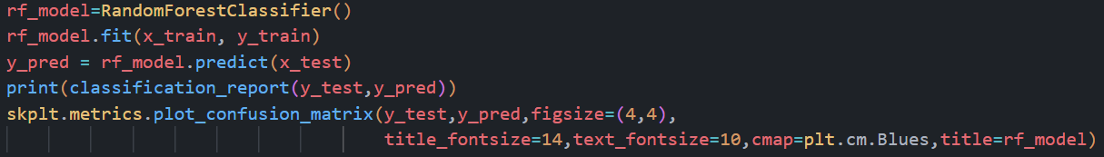
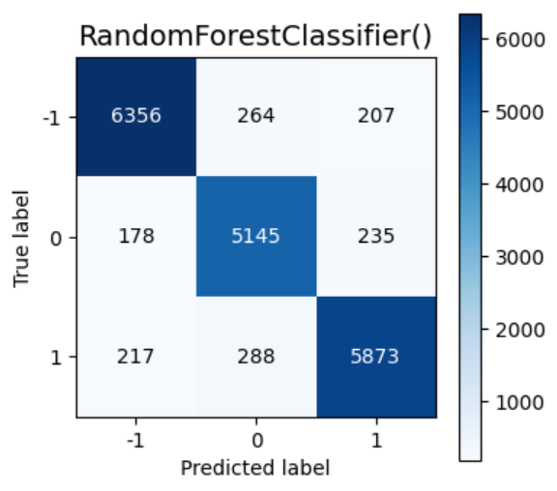
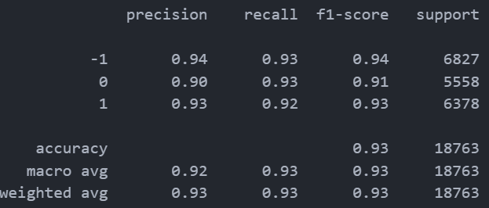
D.Random Forest

Slide 19
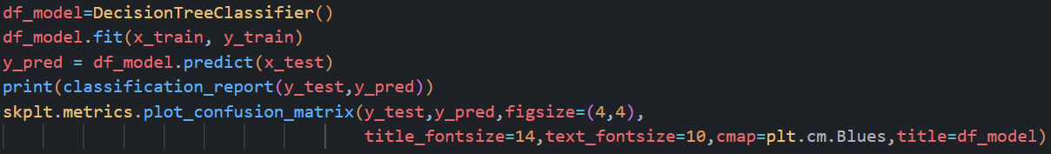
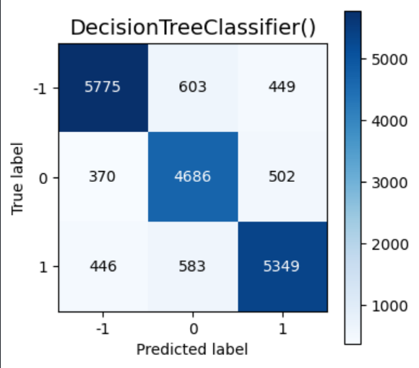
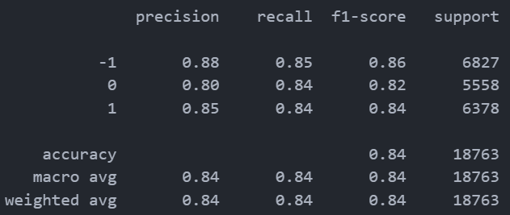
E.Decision Tree

Slide 20
CONCLUSIONS
Accuracy: As far as the accuracy of the model is concerned, SVM and Random Forest perform better than KNN(0.84) ,Naïve bayes(0.78) and Decision Tree(0.84).
F1-score: The F1 Scores for class -1 ,class 0 and class 1 are :
1.For class -1: Multinomial Naive Bayes(accuracy = 0.80) < KNN(accuracy = 0.85) < Decision Tree(accuracy = 0.86) < SVM (accuracy =0.94) < Random Forest (accuracy = 0.94).
2.For class 0: Multinomial Naive Bayes(accuracy = 0.73) < Decision Tree(accuracy = 0.82) < KNN(accuracy = 0.86) < Random Forest (accuracy = 0.91)< SVM (accuracy =0.92).
3.For class 1: Multinomial Naive Bayes(accuracy = 0.79) < KNN(accuracy = 0.81)< < Decision Tree(accuracy = 0.84) < Random Forest (accuracy = 0.93)< SVM (accuracy =0.93).

Slide 21
THANK YOU

